Slide 1
Artificial Intelligence
Machine Learning
05 JAN 2026

Slide 2
Goals
Today’s Goals:
Understand the relationships between different aspects of data science and artificial intelligence
Expose you to different kinds of models you may see or work on in the future
Show various applications
Discuss AI Ethics and its role in responsible innovation
Goals are NOT:
To make you an expert in specific models
To teach detailed coding or mathematics behind algorithms
To cover every possible AI or data science use case

Slide 3
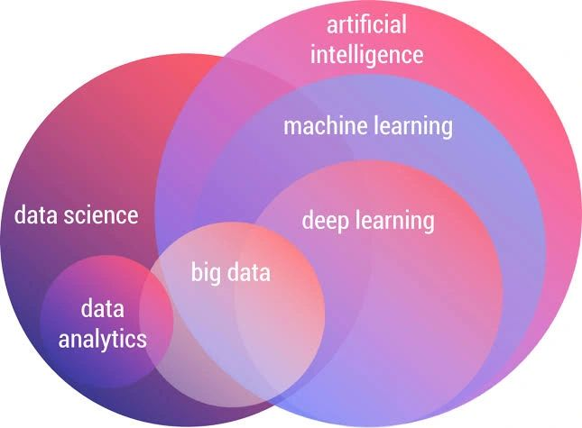
Data Science and AI: How it Fits Together

Slide 4
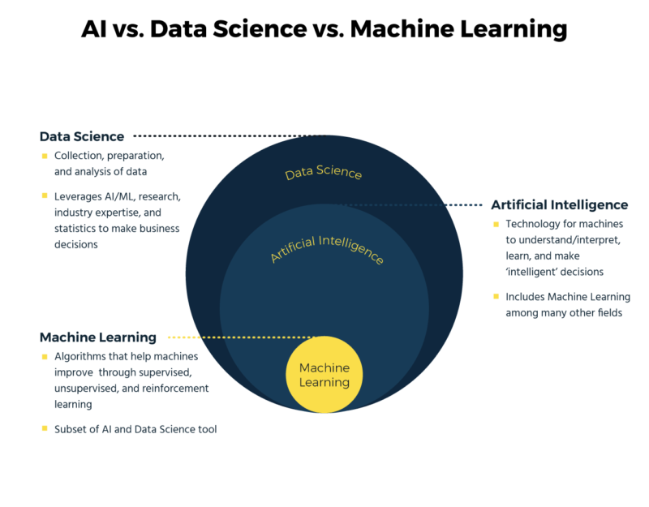
AI/ML
What do we mean by Artificial Intelligence and Machine Learning?

Slide 5
Foundations of Data Science

Slide 6
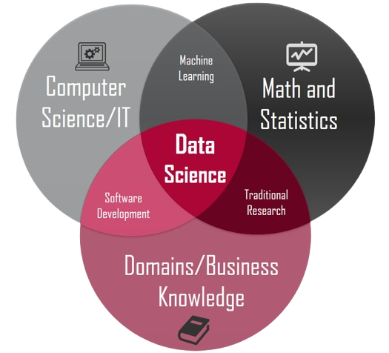
What is Data Science?
Extracts knowledge and insights from data through scientific methods, algorithms, and programming
Interdisciplinary: combines principles from computer science, mathematics, statistics, and domain expertise
Used to ultimately informing decision-making and problem-solving
Includes descriptive, diagnostic, predictive, and prescriptive analytics

Slide 7
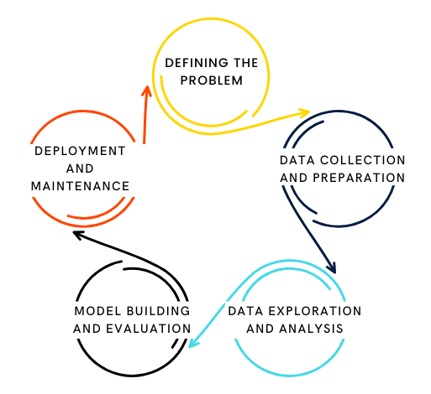
Data Science Lifecycle
A structured, iterative approach that guides data scientists through the process of transforming raw data into actionable insights
Problem definition / Business understanding
Data collection
Data cleaning and preparation
Exploratory data analysis (EDA)
Feature engineering
Model building and evaluation
Model deployment
Monitoring and Maintenance

Slide 8
Tools
Python - considered the most popular language, extensive libraries, used for data manipulation, analysis, visualization, and machine learning
R - language specifically designed for statistical computing and graphics
SQL - language used for relational databases, tool for accessing and preparing data
Excel - easy to store and visualize data, can be hard to manipulate

Slide 9
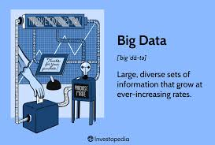
Big Data
The 3(?) Vs:
Volume- sheer quantity of data, measured in terabytes, petabytes, and even exabytes
Velocity- speed at which new data is generated and processed, some internet-enabled smart products operate in real time or near real time and will require real-time evaluation and action
Variety- includes structured data, unstructured data, and semi-structured data sets
Others have emerged:
Veracity- quality, accuracy, and reliability of the data
Value- highlights the necessity of extracting meaningful insights from big data that can benefit the organization
“Big data” refers to extremely large and complex data sets that cannot be easily managed or analyzed with traditional data processing tools

Slide 10
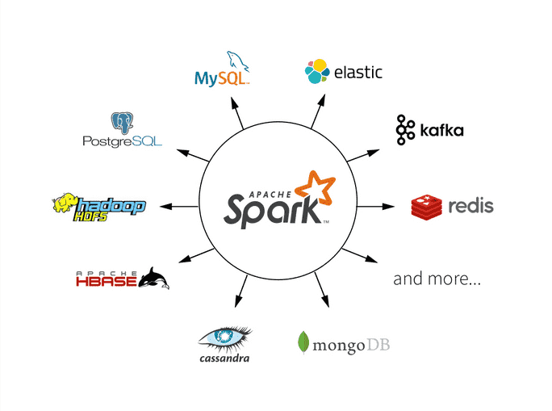
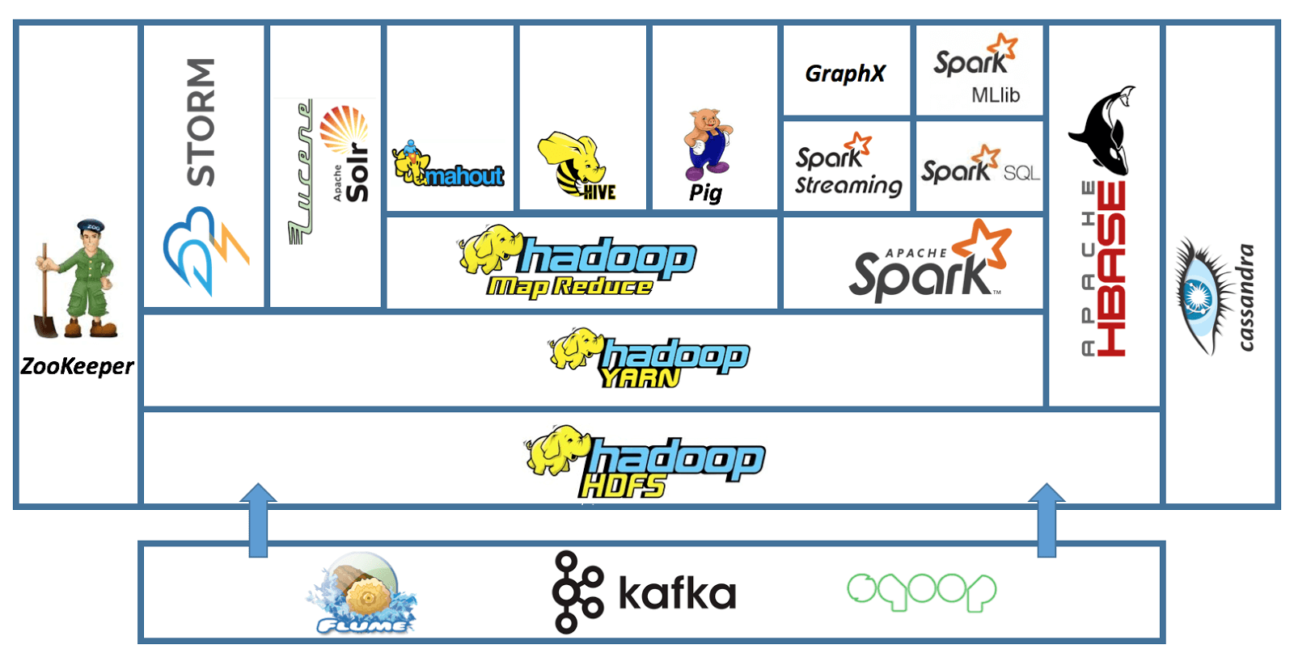
Big Data Tools
Apache Spark - open-source analytics engine for large-scale data processing, well-suited for real-time processing and machine learning tasks due to its in-memory architecture
Hadoop - open-source framework for storing and processing massive datasets across distributed clusters, with a robust storage system (HDFS) and a computational model (MapReduce)

Slide 11
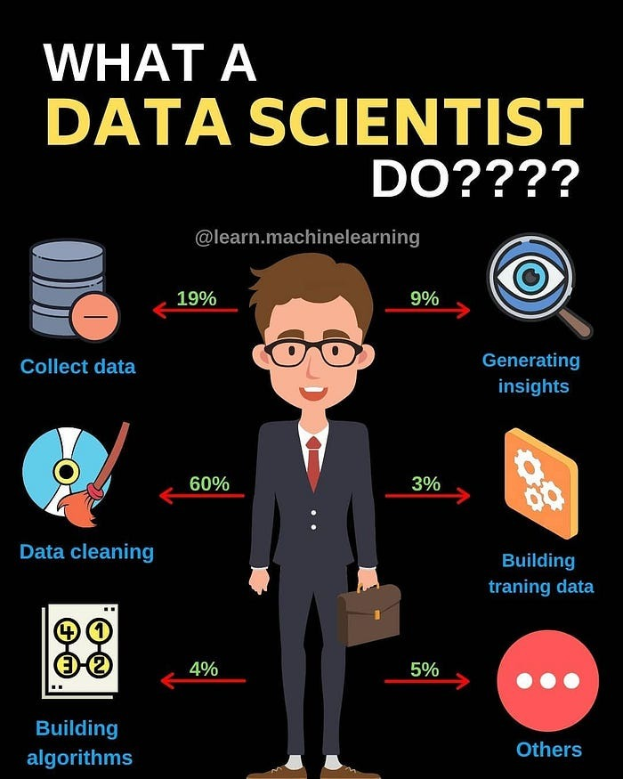
Relation to AI
Data scientists play a crucial role in the success of AI systems by preparing and cleaning datasets, selecting relevant features, and evaluating model performance
Data scientists utilize AI techniques, particularly machine learning algorithms, to analyze data, uncover insights, build predictive models, and automate processes

Slide 12
Core AI Concepts

Slide 13
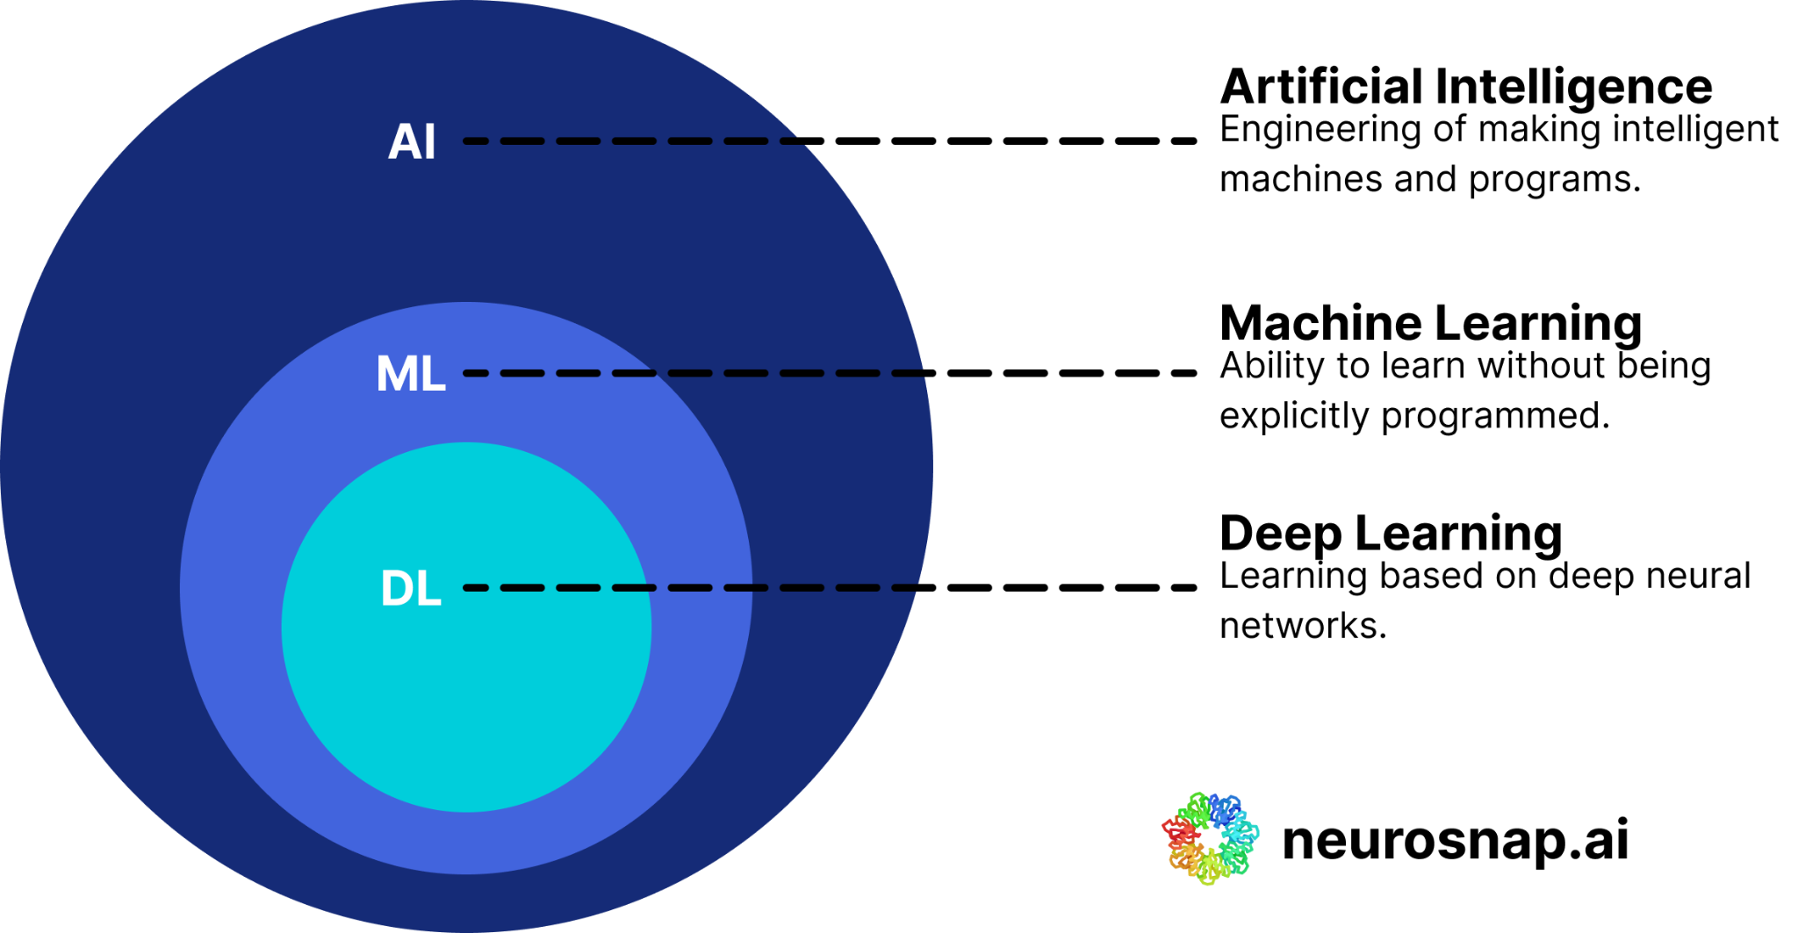
Difference between AI, ML, and DL
Artificial intelligence (AI): The overarching concept
The broadest term, encompassing any system that can mimic human-like intelligence, decision-making, problem-solving, and perception
Machine learning (ML): Learning from data
A subfield of AI that uses algorithms to identify patterns and relationships within datasets to make predictions and improve performance over time
Deep learning (DL): Harnessing neural networks for complex patterns
A specialized subset of ML that utilizes deep neural networks to learn and make complex decisions, they are particularly well-suited for tasks involving large amounts of unstructured data

Slide 14
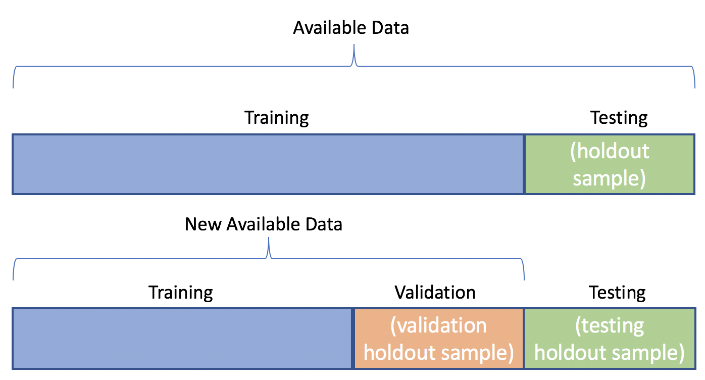
Modeling Process
1. Split data: divide dataset into training, validation, and test
Training set – used to fit the model parameters (weights, coefficients, etc.)
Validation set – used for model selection and hyperparameter tuning
Test set – held out until the very end to provide an unbiased estimate of generalization performance
2. Model selection: Multiple candidate algorithms are compared based on performance metrics
Consider computational cost and interpretability.

Slide 15
Modeling Process Continued
3. Training and Hyperparameter tuning
Hyperparameters (those not learned during training, e.g., learning rate, tree depth, regularization strength) are optimized to improve model performance.
Approaches:
Grid Search – exhaustive search over predefined parameter grid.
Random Search – random sampling from parameter distributions (more efficient for large spaces).
Bayesian Optimization – probabilistic modeling of the objective function to guide search.

Slide 16
Modeling Process Continued
4. Evaluate model performance to estimate true generalization error
Classification Metrics
Accuracy – Proportion of correct predictions out of all predictions.
Precision – Proportion of positive predictions that were actually positive.
Recall – Proportion of actual positives correctly identified.
F1-score – Harmonic mean of precision and recall, balancing both.
ROC-AUC – Measures the ability of the model to distinguish classes across thresholds.
Regression Metrics
MSE – Mean squared difference between predicted and actual values.
RMSE – Square root of MSE; interpretable in the same units as the target.
MAE – Mean absolute difference between predicted and actual values.
R² – Proportion of variance in the target explained by the model.

Slide 17

Modeling Process Continued

Slide 18
Modeling Process
Last week we discussed data exploration and data cleaning broadly
Next is Modeling.
The basic steps to modeling are:
Splitting data to test and train (overfitting is evil)
Cross Validation
Choosing a Baseline model and Model selection
Hyperparameter tuning
Evaluation of Model Performance (accuracy, precision, recall, f1-score)

Slide 19
Role of Data Quality in AI Success
Accuracy – Correct and representative data improves model predictions.
Completeness – Missing data can lead to bias and poor performance.
Consistency – Uniform formats and definitions reduce confusion for models.
Relevance – Data should align with the problem being solved.
Timeliness – Up-to-date data ensures models remain accurate over time.
Noise Reduction – Removing errors/outliers prevents misleading patterns.
Garbage in, garbage out

Slide 20
Exercise - 20 Minutes
You are a data scientist building a simple AI model to predict movie review sentiment (Positive or Negative).
Step 1 – Data Exploration
Read through the dataset.
Highlight positive keywords (e.g., “loved,” “great,” “stunning”) and negative keywords (e.g., “terrible,” “confusing,” “weak”).
Step 2 – Build a Simple Rule-Based Model
In your group, create a list of positive and negative words.
If a review contains more positive words than negative → label as Positive, Otherwise → label as Negative.
Step 3 – Test Your Model
Apply your rule to each review in the dataset.
Compare your predicted sentiment to the actual “Sentiment” column.
Count how many you got correct → This is your accuracy score.
Step 4 – Reflect
How would an AI model improve on your rule-based approach?
What additional data or features would you collect?
Bonus: Is this model prone to overfitting or underfitting?
ID | Review Text | Sentiment
1 | I loved the plot and the acting was great | Positive
2 | Terrible pacing and confusing storyline | Negative
3 | The visuals were stunning | Positive
4 | I wouldn’t recommend this to anyone | Negative
5 | Great soundtrack but weak acting | Negative
6 | A masterpiece from start to finish | Positive

Slide 21
Types of Machine Learning

Slide 22
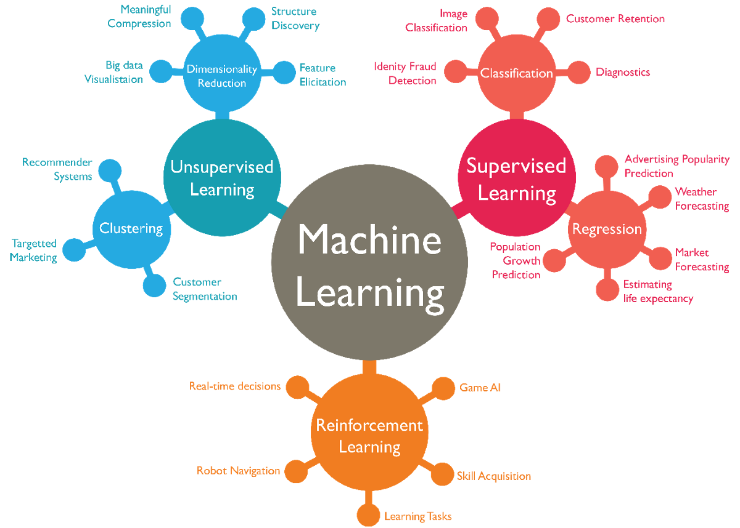
Different Types of ML
Notes:
https://neurosnap.ai/blog/post/understanding-the-differences-between-ai-machine-learning-and-deep-learning/64279cadfeb3e5ca5ba0904a

Slide 23
Machine Learning
A field of AI that learns from data and generalizes to unseen data, allowing programs to learn without explicit instructions
Types of Machine Learning:
Supervised - model is trained on labeled dataset
Unsupervised - model is trained on unlabeled dataset
Semi-Supervised - labeled dataset is relatively small to unlabeled
Reinforcement Learning - computers learn through reward and punishment

Slide 24
Supervised Learning
Concept:
Learn from labeled data (inputs paired with correct outputs)
Model predicts outputs for new, unseen inputs
Classification - predicts categorical outcomes (Yes/No, Type of Animal)
Regression - predicts continuous values (linear vs non-linear relationship)
Example Models:
KNN (K-Nearest Neighbors): Classifies based on closest data points
SVM (Support Vector Machines): Finds the optimal decision boundary to separate classes
Random Forest: Ensemble of decision trees voting for final prediction
Gradient Boosting: Sequentially improves weak learners into a strong model
Naive Bayes: Uses probabilities based on feature independence assumptions
Examples:
Spam email filtering
Predicting house prices
Diagnosing diseases from medical records

Slide 25
Supervised Learning
A type of machine learning where the model is trained on labeled data. The goal is to learn a mapping from inputs (features) to outputs (labels) based on the provided examples.
Classification - predicts categorical outcomes (Yes/No, Type of Animal)
Regression - predicts continuous values (linear vs non-linear relationship)
Pros: High accuracy with informed labeling, Wide range of algorithm choice
Cons: EXPENSIVE (time, SME), Not great if data is difficult to label (audio)

Slide 26
Unsupervised Learning
Concept:
Discover patterns or groupings in data without labels
Helps uncover hidden structure
Clustering - Grouping data points based on features
Dimensionality reduction - Stripping down to essential features
Example Models:
K-Means – clusters data into distinct groups
Gaussian Mixture Models (GMM) – probabilistic clustering with soft assignments
DBSCAN – density-based clustering to find arbitrarily shaped groups
PCA (Principal Component Analysis) – reduces dimensions by finding main variance directions
Examples:
Customer segmentation for targeted marketing
Image compression and feature extraction
Anomaly detection in network traffic

Slide 27
Unsupervised Learning
A type of machine learning where the model is trained on data that has no labeled responses. The goal is to uncover hidden patterns or intrinsic structures in the data.
Clustering - Grouping data points based on features
Dimensionality reduction - Stripping down to essential features
Association Rule Learning - Discovering relationships between variables (Market basket analysis)
Pros: No labeling required
Cons: Prone to overfitting, subjective results

Slide 28
Semi-supervised
Concept:
Combines a small amount of labeled data with a large amount of unlabeled data
Improves learning when labeled data is scarce or expensive to obtain
How it works:
Uses labeled data to guide the learning process
Leverages patterns in unlabeled data to improve model accuracy
Common Techniques:
Self-training
Graph-based methods: relational through nodes and edges
Generative models: Learn off distribution data
Examples:
Image recognition with limited annotations
Speech recognition using a few transcribed audio samples

Slide 29
Semi-supervised Learning
A machine learning approach that uses a small amount of labeled data along with a large amount of unlabeled data to improve learning accuracy and generalization. Can be used in text classification, image recognition.
Generative Models - Learn off distribution data
Graph Based - relational through nodes and edges
Multiview Learning - learns from multiple perspectives of data (computer vision)
Pros: Cost, unlabeled data can enhance performance
Cons: Overfitting, quality of unlabeled data

Slide 30

Reinforcement Learning
Concept:
Learn by trial and error through interaction with an environment
Receive rewards or penalties based on actions
Goal: maximize cumulative reward over time
Examples:
Game-playing AI (e.g., Chess, Go, video games)
Robot navigation and control

Slide 31
Reinforcement Learning
A type of machine learning where an agent learns to make decisions by interacting with an environment to maximize cumulative reward. Used by games and robots
Needs the following: Agent, environment, set of actions, states, reward system (Positive vs negative reinforcement learning)
Pros: Solving complex problems and non-deterministic environments, combine with other algorithms
Cons: Lots of data and compute power, poor reward design

Slide 32
Exercise - 20 minutes
Groups of 2-3
Research assigned algorithm. What type of machine learning is it? Briefly describe algorithm and any application found.
Q-Learning
GMMs
GANs
SVM
PCA
Adaboost
Random Forest
Monte Carlo
KNN
Naive Bayes
Decision Trees
Gradient Boosting
Logistic Regression
Markov Chains

Slide 33
Exercise - Machine Learning Algorithms
Groups of 2-3
Research assigned algorithm. What type of machine learning is it? Briefly describe algorithm and any application found.
Q-Learning
GMMs
GANs
SVM
PCA
Random Forest
Monte Carlo
KNN
Naive Bayes
Gradient Boosting

Slide 34
Deep Learning

Slide 35
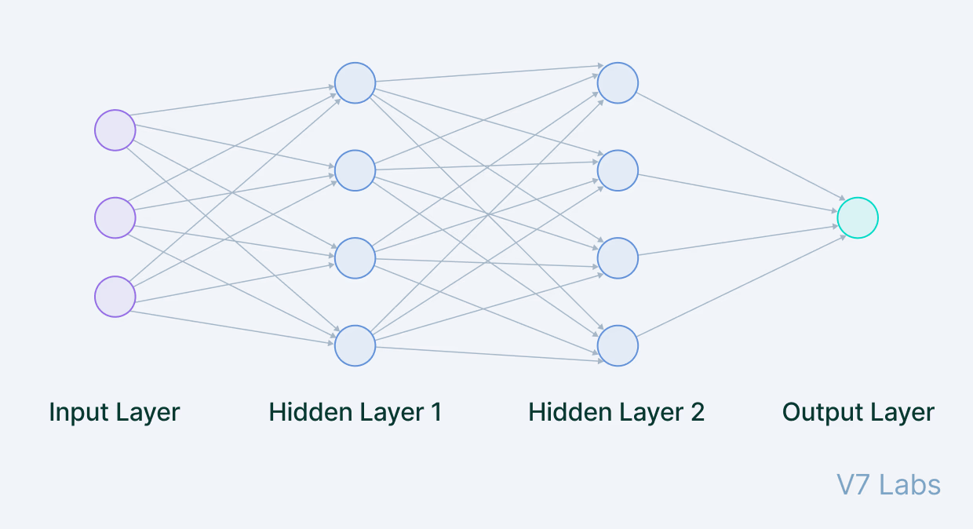
Neural Networks
Concept:
Inspired by the brain’s network of neurons
Consists of layers of interconnected nodes (neurons)
Learns complex patterns by adjusting connection weights
Architecture:
Input Layer: Receives raw data
Hidden Layers: Perform computations and feature extraction
Output Layer: Produces predictions or classifications
Each neuron applies a weighted sum and an activation function (e.g., ReLU, Sigmoid)

Slide 36
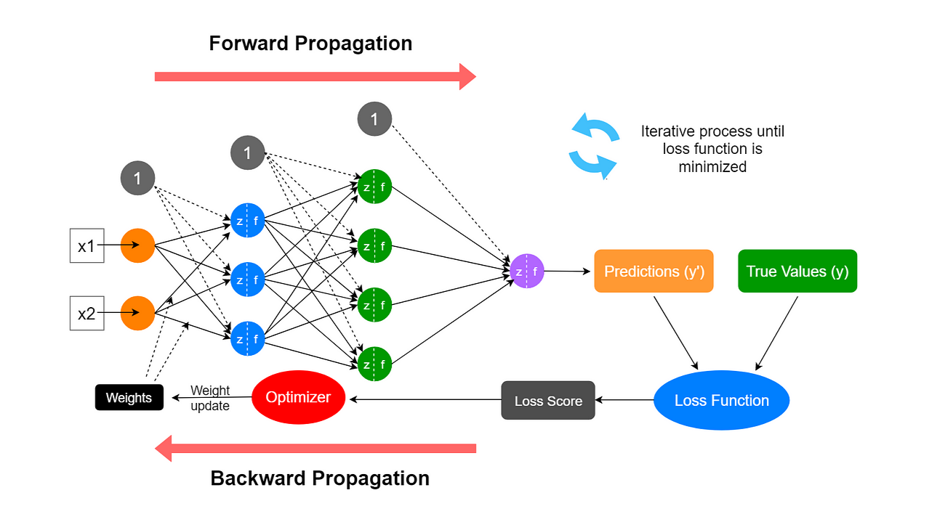
How Neural Networks Learn
Use forward propagation to compute outputs from inputs
Calculate error using a loss function (difference between predicted and actual)
Use backpropagation to update weights based on error gradients
Repeat over many iterations (epochs) to improve accuracy

Slide 37
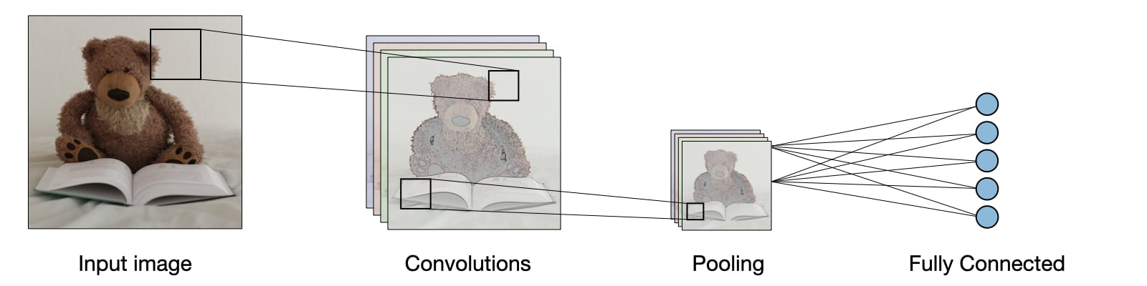
CNNs
CNNs (Convolutional Neural Networks)
Designed for image and spatial data
Use convolutional layers to detect patterns like edges, textures, and shapes
Excellent for tasks like image classification, object detection, and segmentation

Slide 38
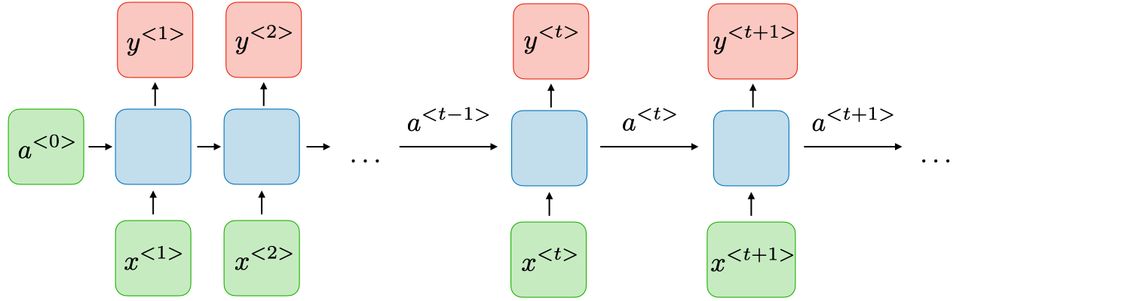
RNNs
RNNs (Recurrent Neural Networks)
Designed for sequence data such as text, speech, or time series
Maintain memory of previous inputs via loops in the network
Used in language modeling, speech recognition, and time-series forecasting

Slide 39
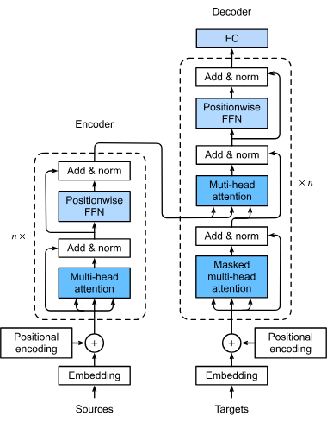
Transformers
A deep learning model, primarily used in natural language processing
Relies on self-attention mechanisms to process input sequences and generate output sequences
Can process elements of a sequence in parallel, leading to improved training speed and efficiency
Examples: ChatGPT, Claude, Gemini

Slide 40
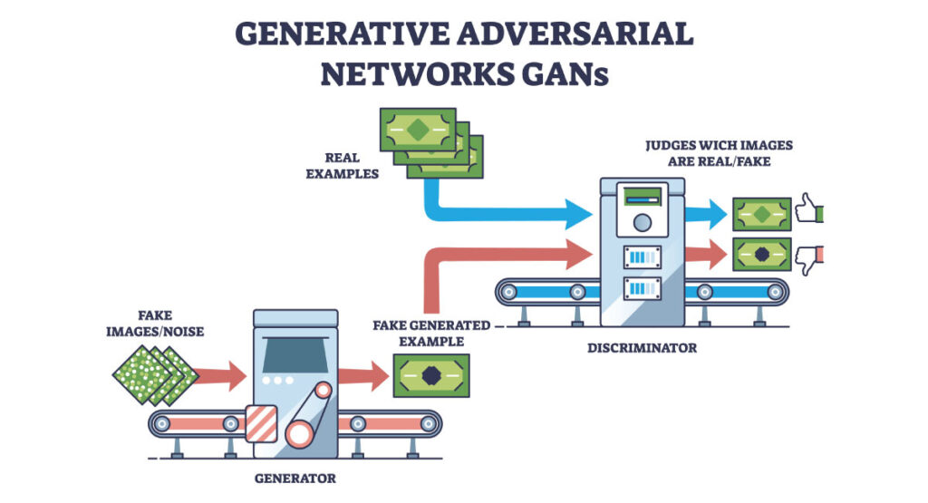
Generative Adversarial Networks (GANs)
Concept:
Consist of two neural networks — a Generator and a Discriminator — competing against each other
Generator: Creates fake data trying to mimic real data
Discriminator: Tries to distinguish between real and fake data
Training Process:
The generator improves by learning to fool the discriminator
The discriminator improves by getting better at spotting fakes
This adversarial “game” continues until the generator produces highly
realistic data
Applications:
Creating realistic images, videos, and audio
Image-to-image translation (e.g., turning sketches into photos)
Data augmentation for training other AI models
Examples:
DALL-E
Stable Diffusion

Slide 41
Computer Vision

Slide 42
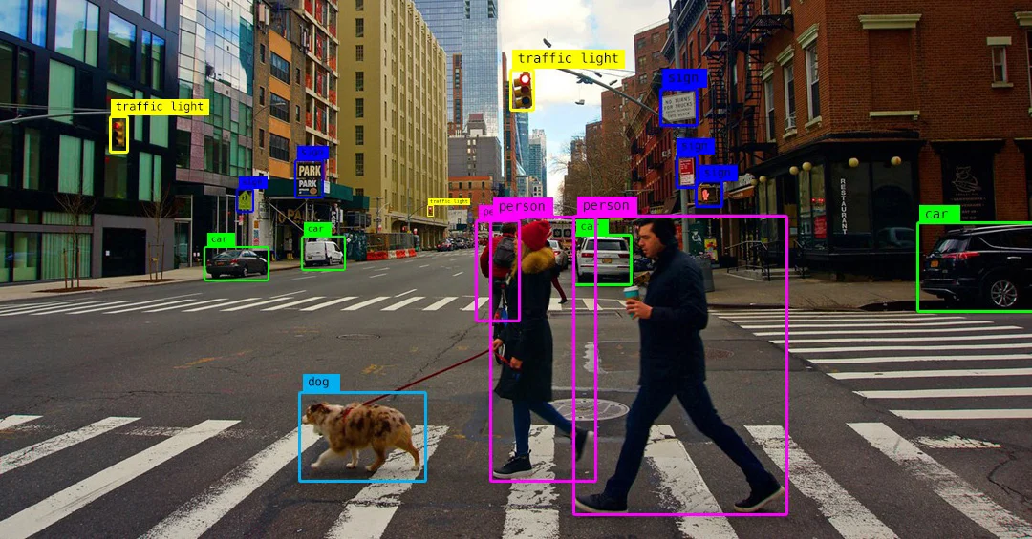
How Computers “See” Images
CV systems leverage cameras and other sensors to acquire images or video data, and then employ advanced algorithms and ML models to process and interpret this visual information
Key Steps:
Image Acquisition: The process begins with image acquisition, which could be a single frame from a video, a photo from a camera, or even a live feed.
Preprocessing: The image may need to be converted from RGB to grayscale, normalized, or resized to prepare for analysis.
Feature Extraction: The system identifies key features in the image that are necessary for understanding its content.
Recognition: After feature extraction, the system compares the features to known labels to recognize objects or patterns.
Interpretation: The final step involves making sense of the recognized objects, often involving complex decision-making or learning over time.

Slide 43
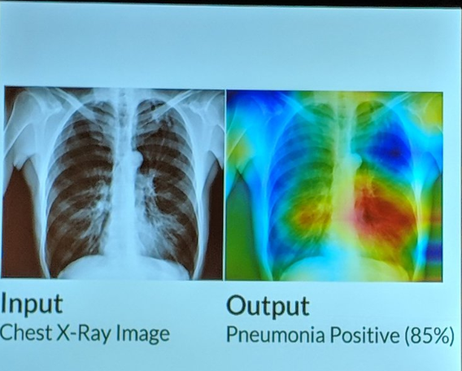
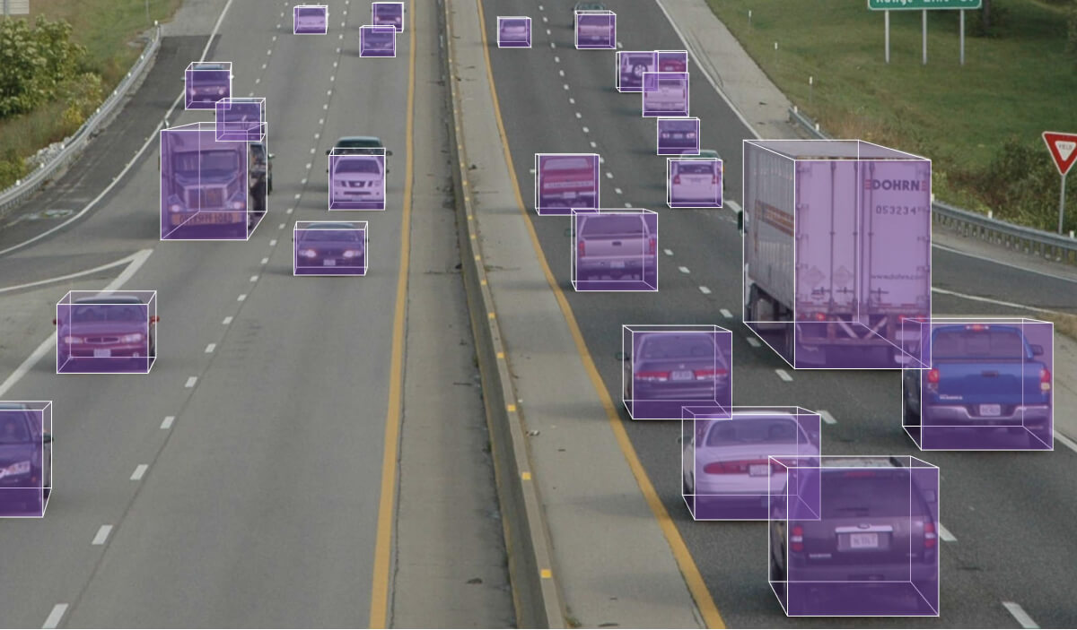
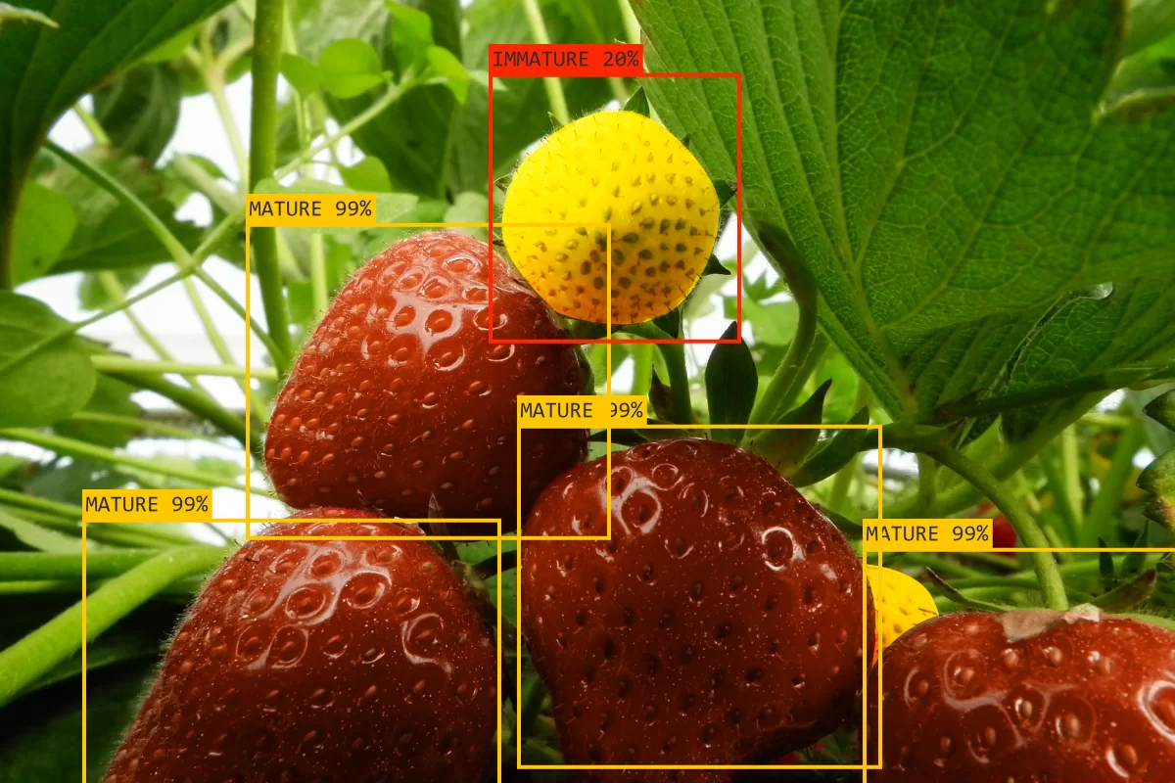
Applications
1. Healthcare:
Medical Image Analysis: Assisting in diagnosis and treatment planning.
Surgical Guidance: Providing real-time visual information to surgeons during procedures.
2. Automotive:
Self-Driving Cars: Enabling vehicles to perceive their surroundings, detect objects, and navigate safely.
Driver Assistance Systems: Providing features like lane keeping, adaptive cruise control, and automatic emergency braking.
3. Retail:
Loss Prevention: Detecting shoplifting and preventing theft.
Automated Checkout: Enabling cashier-less shopping experiences.
4. Agriculture:
Crop Monitoring: Assessing crop health, detecting diseases, and optimizing irrigation.
Precision Farming: Applying resources like fertilizer and pesticides only where needed.

Slide 44
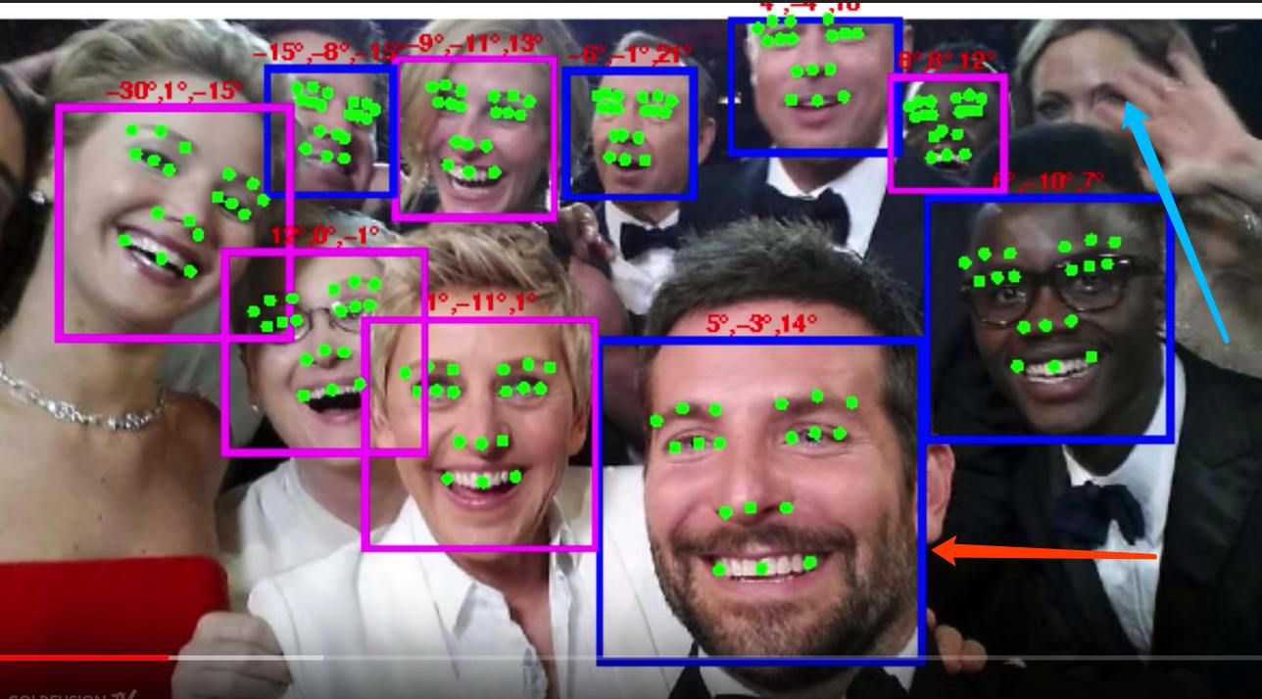


Applications Continued
5. Security and Surveillance:
Facial Recognition: Identifying individuals for security purposes.
Object Detection: Monitoring for suspicious activities and unauthorized access.
Crowd Analysis: Monitoring large gatherings for safety and security.
6. Manufacturing:
Quality Control: Inspecting products for defects and ensuring they meet quality standards.
Predictive Maintenance: Identifying potential equipment failures before they occur.
7. Other Applications:
Entertainment: Enhancing special effects in movies and games.
Robotics: Enabling robots to interact with their environment.
Sports: Tracking player movement and analyzing game performance.
Notes:
https://medium.com/geekculture/track-a-tennis-ball-with-computer-vision-4f8d2f9c0412

Slide 45
Robotics and AI Integration

Slide 46
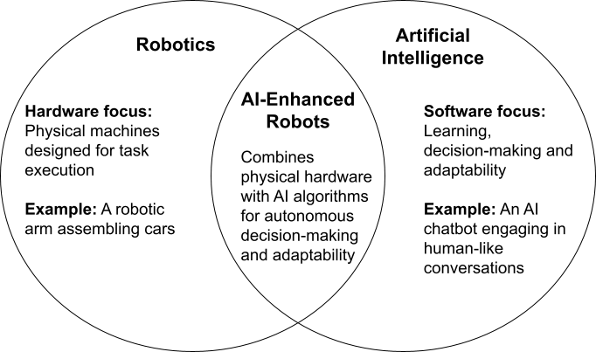
How Does Robotics Fit Into AI?
Robotics fits into AI as a physical application of intelligent systems—AI provides the “brain” for decision-making, learning, and perception, while robotics is the “body” that interacts with the physical world to sense, move, and manipulate objects.

Slide 47
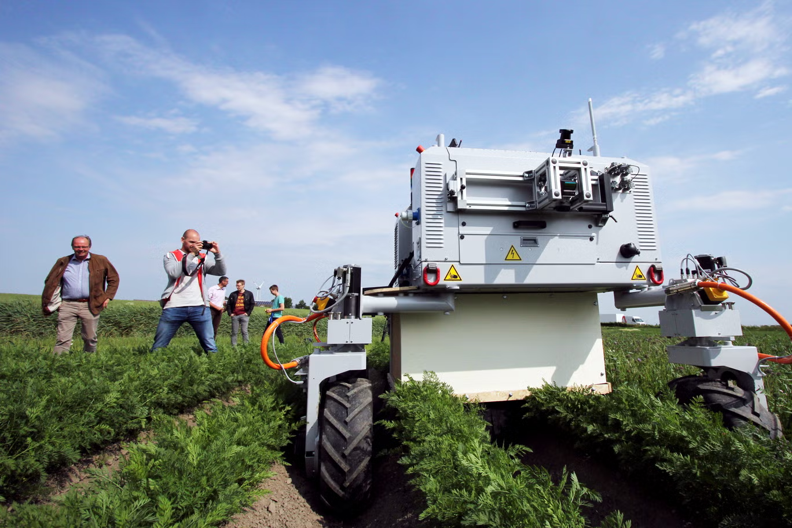
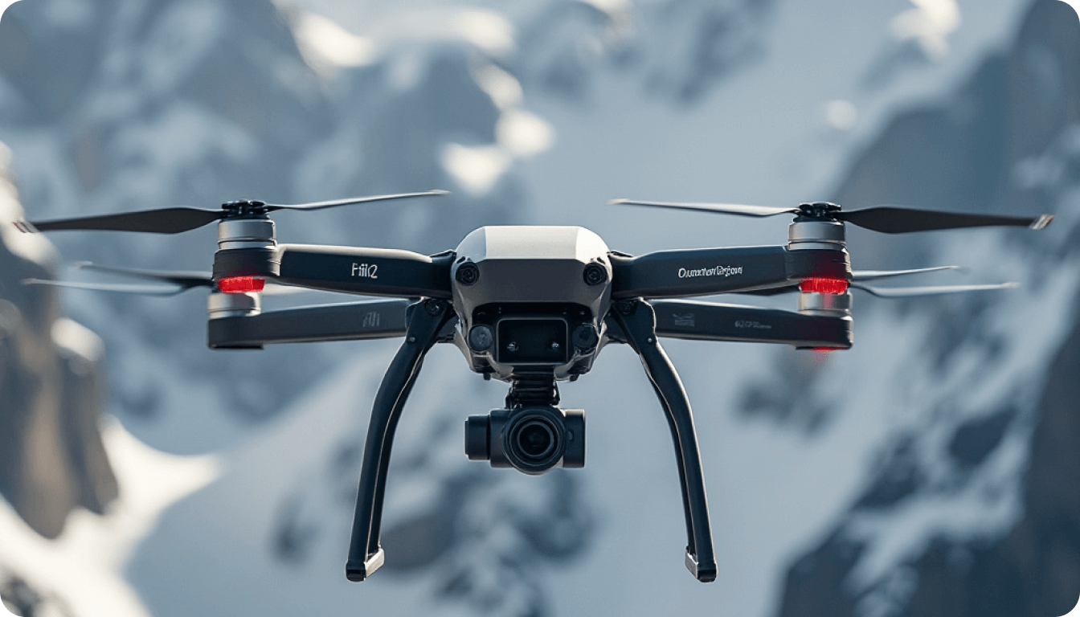
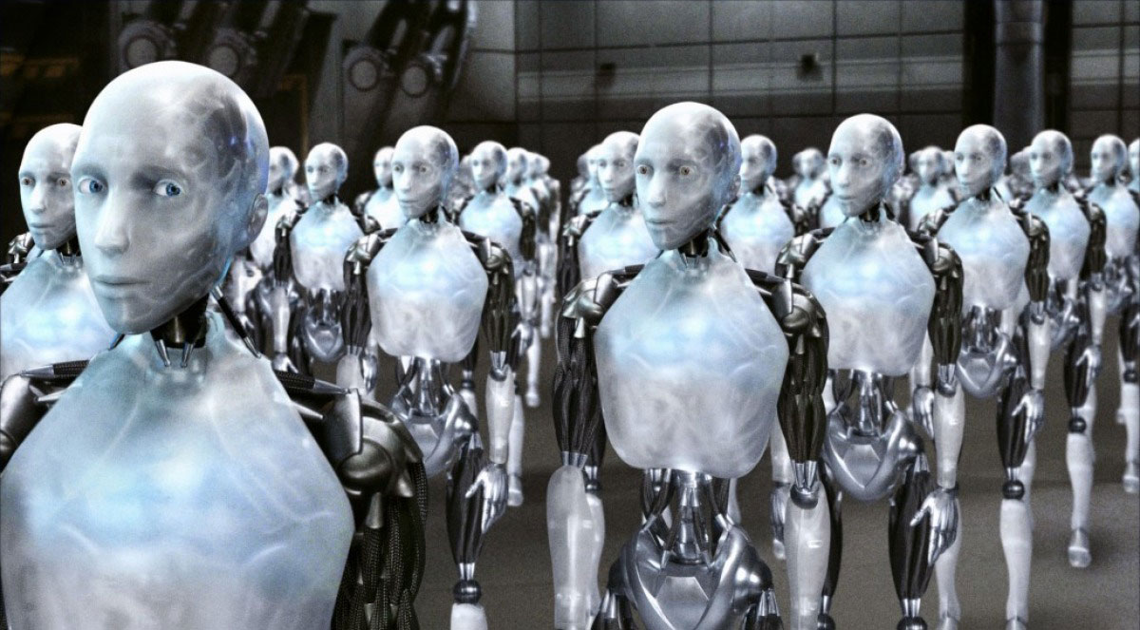
What Is an AI Robot?
AI robots can typically be defined by having three core qualities:
Sensors – These provide the robot with the ability to perceive its environment. Examples include cameras, LiDAR, ultrasonic sensors, microphones, GPS, and touch sensors.
Actuators – These allow the robot to interact with and move within its environment. Examples include wheels, robotic arms, motors, and grippers.
Software – This is the “brain” of the robot, enabling learning, reasoning, and decision-making. It includes AI algorithms, control systems, and path-planning logic.
When combined, these components allow an AI robot to sense, think, and act—making it capable of performing tasks autonomously or semi-autonomously in real-world environments.

Slide 48
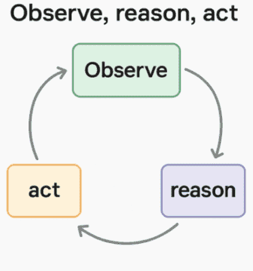
How AI Enables Autonomy
Perception enables autonomy by allowing a system to sense, interpret, and understand its environment, so it can make informed decisions and act without human input.
Gathering information – Sensors (like cameras, LiDAR, microphones, or touch sensors) collect raw data about the robot’s surroundings.
Interpreting the environment – Software processes this data to recognize objects, detect obstacles, identify people, and understand spatial relationships.
Contextual awareness – The robot can determine what is happening around it (e.g., a moving person, a closed door, an uneven surface) and where it is in that space.
Decision-making – With this situational understanding, the robot can choose appropriate actions—whether it’s avoiding an obstacle, picking up an object, or navigating to a goal location.

Slide 49
Exercise - 20 minutes
As a group, design a robot and discuss challenges and opportunities.
Scenarios:
A robot that sorts recyclable vs. non-recyclable items.
A robot that assists visually impaired people indoors.
A robot that monitors crops and detects plant diseases.
A security robot that detects intruders or suspicious activity.
For your scenario, define:
Sensors – What the robot needs to perceive its environment (cameras, LiDAR, infrared, microphones, etc.)
Actuators – How the robot moves or interacts (wheels, arms, grippers)
AI Models – What type of model will process the sensor data?
Answer as a group:
What are potential data challenges? (lighting, occlusion, noise)
How would the robot learn over time? (supervised learning, reinforcement learning, semi-supervised)
What safety concerns must you consider?

Slide 50
AI, Data Science, and Ethics

Slide 51
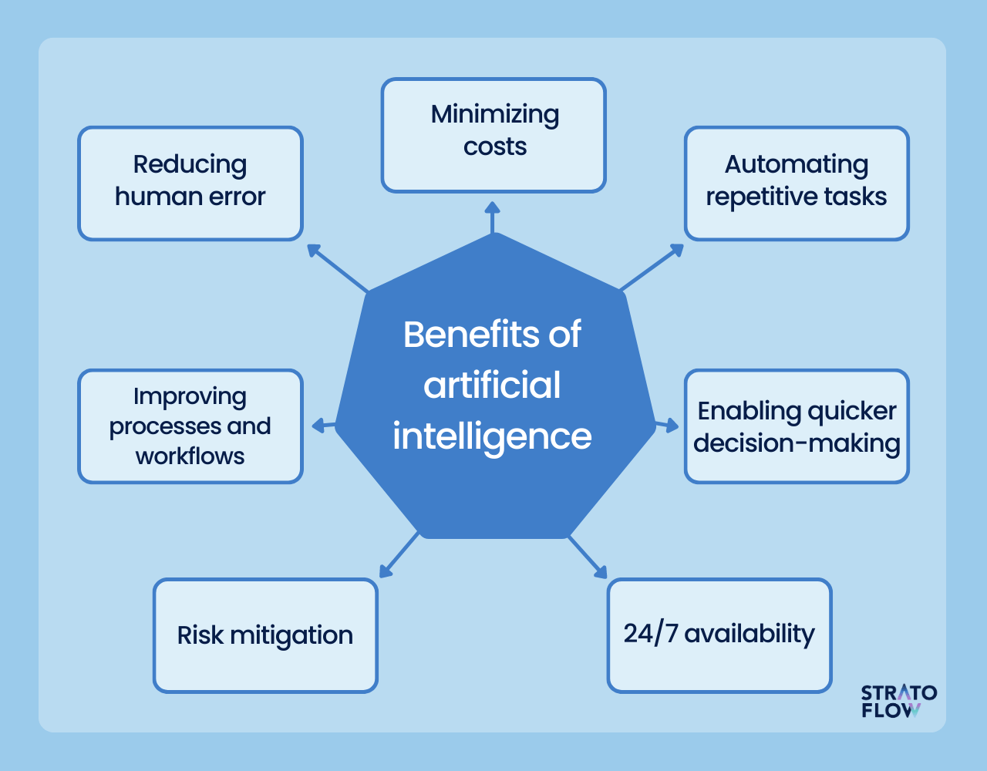
Benefits and Opportunities
Enhanced Productivity – Automates repetitive or complex tasks across industries
Improved Accuracy – Reduces human error in diagnostics, forecasting, and decision-making
Innovation Acceleration – Speeds up R&D in healthcare, materials, and technology
Scalability – Processes massive datasets efficiently
Cost Savings – Optimizes operations and resource usage
Accessibility – Improves services like language translation, education, and assistive tech
New Business Models – Enables personalized services, recommendation engines, and AI-driven products
Predictive Analytics – Anticipates trends, risks, and maintenance needs

Slide 52

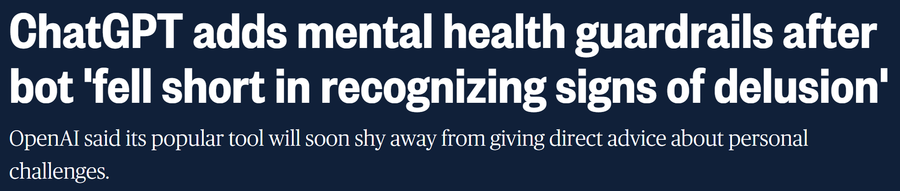
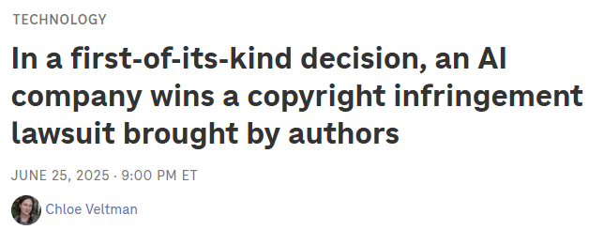


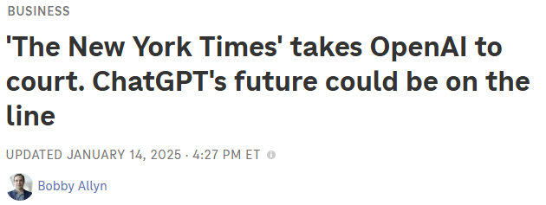
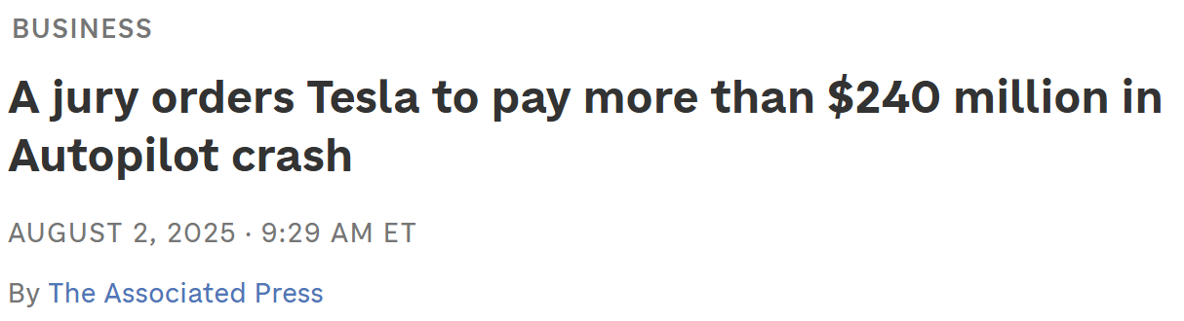
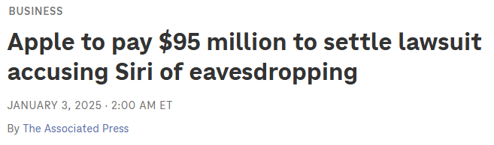

Risks
Bias – Models can inadvertently perpetuate or amplify societal biases due to biased training data or algorithmic design. Exs: Amazon recruiting, COMPAS algorithm, DALL-E
Privacy Concerns– Sensitive personal data may be misused or exposed
Accountability– Who is responsible for a bad decision?
Dependence on AI– Overreliance may lead to a loss of creativity, critical thinking skills, and human intuition
Job Displacement – Automation can replace certain roles, requiring workforce adaptation
Gaps in Laws – Regulations often lag behind AI capabilities, creating legal and ethical challenges
Notes:
https://www.crescendo.ai/blog/ai-bias-examples-mitigation-guide

Slide 53
AI Ethics
Grounded in several key principles:
Fairness and Non-discrimination: Ensuring AI systems treat all individuals impartially, avoiding biases that could lead to discriminatory outcomes based on factors like race, gender, religion, or socioeconomic status
Transparency and Explainability: Making AI models understandable and their decision-making processes transparent
Accountability: Establishing clear responsibility for AI actions and decisions, with mechanisms for addressing potential harm or error
Privacy and Data Protection: Respecting user privacy and protecting personal data collected and processed by AI systems, adhering to regulations like GDPR and CCPA
Safety and Reliability: Developing AI systems that are robust, secure, and function as intended, minimizing the potential for harm to individuals or society

Slide 54

Solutions
Developing Ethical Frameworks: Establishing clear guidelines and principles to guide responsible AI development and deployment
Ethical AI Governance: Creating robust governance structures, including ethics committees and review processes, to oversee AI initiatives
Technical Safeguards: Implementing measures like bias detection and mitigation techniques, explainable AI (XAI) tools, and privacy-preserving AI architectures
Stakeholder Engagement: Involving diverse stakeholders, including users, ethicists, policymakers, and communities, in the design and development of AI systems
Regulation and Policy: Developing and implementing regulations and laws to govern AI development and use, like the EU AI Act

Slide 55
Exercise - 15 minutes
Facial Recognition at Airports – A system flags potential suspects, but certain demographics are misidentified more often.
AI Hiring Tool – Screens resumes automatically but has historically favored certain genders and backgrounds.
Predictive Policing – Predicts crime hotspots based on historical data, potentially reinforcing biased patterns.
Health Diagnosis App – Uses AI to recommend treatments but sometimes misclassifies rare conditions.
Step 1 – As a group, review your mini case study
Step 2 – Discuss Questions
For your scenario, answer briefly:
What ethical risks are present?
Who might be harmed if the system fails?
How could the design be improved to mitigate risks?

Slide 56
Sklearn
Popular Machine learning library with python that integrates seamlessly with numpy and pandas
Already has many machine learning model types built in (but you can always build your own of course)

Slide 57
Ethics
Bias - systematic favoritism that can lead to unfair results for certain groups
Explainability - being transparent about how ML models are making decisions
Privacy - responsibility of protecting people’s data
Accountability - realizing the impact of ML models
Misuse - understanding how ML technologies can be used for harm
Alexa Speakers

